Slide 1

Mechanics
of Escapement Goal Analysis in Alaska
Picking a Type of Goal and Method of Analysis:
Factors in the selection
Targeted Stocks
no stock-specific data
few data on escapements or catches
sufficient data on escapements with few data on catches
sufficient data on escapements and catches
sufficient data, insufficient information
determining ranges/lower bounds
being prepared for changing goals
Non-targeted Stocks
Notes:
Now that we have some terminology and theory let’s put them into practice in the real world.
One thing to remember, though, is that - picking a goal and doing an analysis are not the same!
In this section of the workshop we will cover:
factors in selecting a goal (maybe you don’t need a goal)
types of goals and analyses for targeted stocks
sufficient data and insight into determining ranges and lower bounds
preparing for a change in goals
and goals and analysis for non-targeted stocks

Slide 2
Factors in Choosing between
BEGs, SEGs, or Having a Goal at All
species
targeted vs. non-targeted stocks
amount of data available
amount of information in data
fishing power – past and future
average harvest rate
variation in harvest rates
ability to manage the fishery inseason
cost to users from a change
Notes:
Species – the species we are managing for may have a role in the types of analyses we can do which affects the type of goal we can set.
Targeted vs. non-targeted – the stocks involved and how the fishery will be prosecuted will definitely affect the type of goal we set
The amount of data is what most people focus on and it does affect the type of goal and analyses we can do
However, the information content of those data have a much greater bearing on what we can do to set a goal
Fishing power/harvest rate directly affects the amount of information available to set a goal as we shall see in the next section and the lab.
And lastly, considerations of the fishery in terms of management for the goal and what users concerns are can drive the setting of an escapement goal (this is why managers are needed in escapement goal reviews).

Slide 3
Adding or Eliminating Escapement Goals:
Establishing or keeping a goal at all presumes that stock-specific data on escapements will be available in the future regardless of their availability in the past.
No Goal Needed (NGN) if in the future there will be no stock assessment to estimate, index, or count escapement, even if there is stock-specific information from past stock assessment. An unfortunate, but necessary rule given finite funding.
Notes:
NO STOCK ASSESSMENT = NO GOAL NEEDED

Slide 4
Review of Goal Types
BEG range – highest potential for achieving MSY
SEG range – achieve sustainable yields over entire range
Lower Bound SEG – sustainable yields with considerations
SET – avoid jeopardy of extirpation
Notes:
Brief reminder of key elements of different escapement goal types.
We will not be discussing Sustained Escapement Thresholds as part of this course.

Slide 5

Guidelines & Procedures for Choosing a BEG, SEG,
or Have a Goal at All
based on PRECAUTIONARY principles & PRACTICALITY
Non-Targeted
Stock
Targeted Stock
No
Stock-specific
data
FEW
Escapement
AND
Catch data
MANY
Escapement
AND
FEW Catch data
MANY
Escapement
AND
Catch data
Pink
Chum
Sockeye
Chinook
Coho
Do not attempt establishing a Lower Bound SEG with a habitat model if there will be no stock assessment in the future.
SOL
LB SEG
based on Ŝ_{MSY}
from “general”
habitat model
Notes:
We have created these flowcharts to help guide you through the process. They are based on practical experience with a healthy dose of the precautionary principle.
The first question we ask is whether the stock is stock targeted or not? Let start with the targeted stocks.
From here we then evaluate the amount of stock-specific data that we have for both escapement and catch…
NO stock-specific data – in most cases we’re SOL, but for coho and Chinook there are some tools we can use. Some may argue that we have similar tools for sockeye, but experience tells us that they do not perform very well without data to validate them. For Chinook and coho we have what are called habitat models.

Slide 6
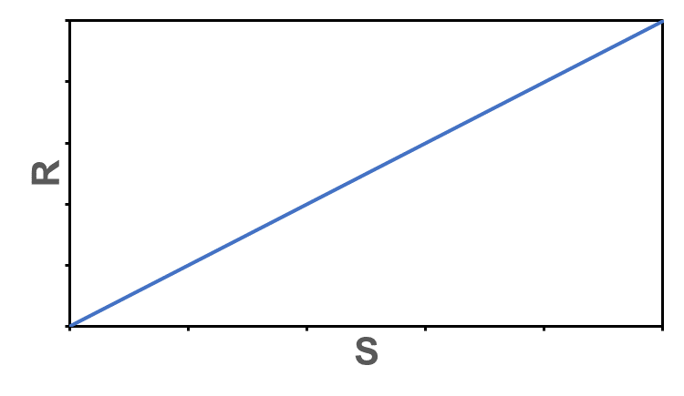
Targeted Stocks –
No Stock-Specific Data
The Situation
Notes:
As we progress through this lecture, we will be showing figures like this – plots of escapement vs. recruits with the replacement line.
At this point, here is what a plot of our data would like
We will have to rely on information from other stocks…

Slide 7
Targeted Stocks –
No Stock-Specific Data –
Watershed Model for Chinook: (1)
Based on premise that equilibrium abundance (S_{EQ}) is specific to watershed area and intrinsic rate of increase is specific to large geographies.
Regressing estimates of S_{EQ} against watershed area for 25 populations (stream and ocean-type) from Oregon to the Yukon River:
Parken, C. et al. 2006. Habitat-based methods to estimate escapement goals for Chinook salmon stocks in British Columbia, 2004. Res. Doc. 2006/083. Ottawa, ON: Canadian Science Advisory Secretariat.
T & M - No Data
59
Notes:
59
The Chinook watershed model is the most highly refined. It is a meta-analysis of 25 stocks from Oregon to the Yukon River. Ricker type analyses were done on each stock. Estimates of S_{MSY} and S_{EQ} are regressed against watershed area. The bigger the watershed the larger the S_{EQ} (i.e. equilibrium abundance). There are separate relationships for stream type (1-check) and ocean type (0-check) chinook.

Slide 8
Targeted Stocks –
No Stock-Specific Data –
Watershed Model for Chinook: (2)
]
where W is watershed size in km² below any barriers to
upstream migration on 4th order or higher streams
Using relationships for Ricker’s model involving biological reference points
with substitutions of estimates from the watershed models:
T & M - No Data
60
Notes:
60
The watershed area is measured in square kilometers below barriers to migration. As you can see it’s a log-log regression so the relationship is actually a power curve. By plugging in the watershed area where your stock resides you get estimates of S_{MSY} and S_{EQ} but you also get a generic Ricker production curve…
Notice that ln alpha is assumed to be 1.46
REMEMBER the equation to estimate S_{MSY} – this will be useful to us many times as we work our way through an EGA.
Only one stock in Alaska has an escapement goal that has used this method – Nelson River. It was mainly used to corroborate SRA
This analysis was updated and converted to a Bayesian framework by Liermann et al. (2010), and is the paper one should use for estimates of the relation between watershed size and S_{EQ} as well as ln alpha. We will touch on Liermann et al. again later.

Slide 9
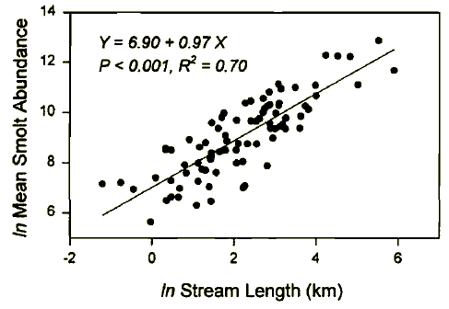
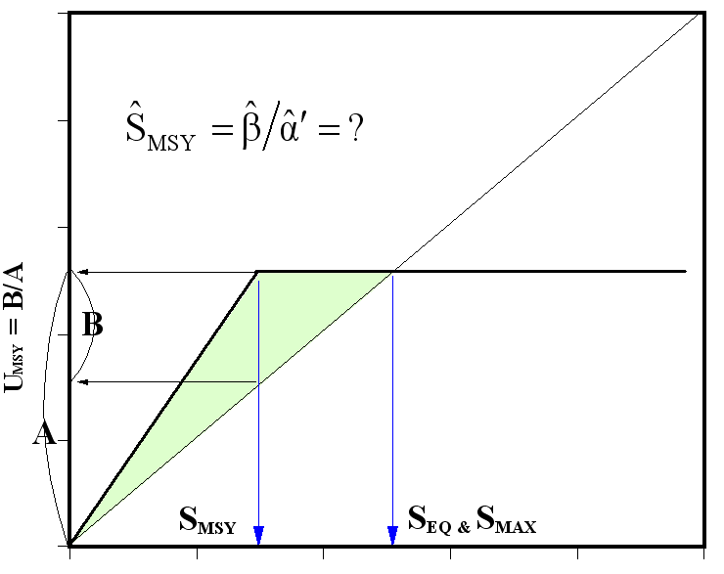
Targeted Stocks –
No Stock-Specific Data –
Stream Length Model for Coho:
Based on assumption carrying capacity of smolts is related to stream length and general estimate of α′ = 42.5 smolts per spawner
Using biological reference points equations from hockey stick model estimate S_{MSY}
Questions:
Will an escapement goal that max. smolt production also max. yields?
Is there “overcompensation”?
Would an SEG be defensible?
Bradford, M.J. et al. 1997. Empirical review of coho salmon smolt abundance and the prediction of smolt production at the regional level. Trans. Am. Fish. Soc. 126:49-64.
Bradford, M.J. et al. 2000. Reference points for coho salmon (Oncorhynchus kisutch) harvest rates and escapement goals based on freshwater production. Can. J. Fish. Aquat. Sci. 57:677-686.
Notes:
We also have a watershed model for coho, but it is much less refined than the Chinook model. Data are from 83 systems. The number of smolts produced is related to the stream length using a power function like the chinook habitat model. These smolt abundances, however, were likely from stocks under exploitation so they may not reflect carrying capacity.
There is also a general relationship based on data from the Pacific Northwest for number of smolts produced per adult at low spawner numbers that can be used as a proxy for smolt production. A hockey stick model was used here, but a Beverton-Holt model could have been used as well. This number (42.5 smolts per spawner) seems to be a pretty good average for SEAK as well.
Putting the two relationships together gives us a production model for smolt based on length of the stream and a hockey stick model of production of smolt. So we can specify the escapement that maximizes smolt production but will this maximize yields of returning adults?
Are these goals defensible? Currently, there are no escapement goals in Alaska that have used this approach.

Slide 10
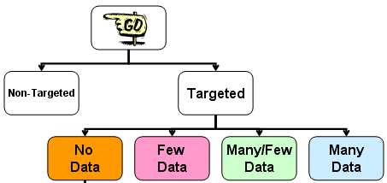
Procedures for Choosing
BEGs, SEGs, or ….
FEW
Escapement
AND
Catch data
Escapements counted/estimated; no stock-specific catch counts/estimates
OR
Escapements indexed; few stock-specific catch counts/estimates
Chinook
Coho
“lake” sockeye
Pink
Chum
“river” sockeye
High Harvest
Rate
Low to
Moderate
Harvest
Rate
Unknown
Harvest
Rate
High Harvest
Rate
>40%
Low to
Moderate
Harvest
Rates
Unknown
Harvest
Rate
SEG RANGE
“habitat”
or “paleo”
model
No Goal
Needed
(Low HR only)
LB SEG
”habitat”
or “paleo”
model
Improve
stock
assessment
No Goal
Needed
(Low HR only)
LB SEG
Percentile
Approach
Improve
stock
assessment
SEG
“habitat”
or “paleo”
model
LB SEG
Percentile
Approach
SEG
Percentile
Approach
SEG
Percentile
Approach
Notes:
Now we have some escapement data or maybe some escapements and some good catch info. What can we do now?
We may now have some idea of what the harvest rate is, and this plays an important role in what analysis we can do.
We also have some tools that can be used for lake rearing sockeye salmon as well as the other species (chum & pinks). So adding to our 2 previous habitat models we have a paleolimnology model for sockeye and the percentile approach.
You can see here that were still clearly in SEG country – we likely cannot and need not specify a BEG range for stocks with these kinds of data.

Slide 11
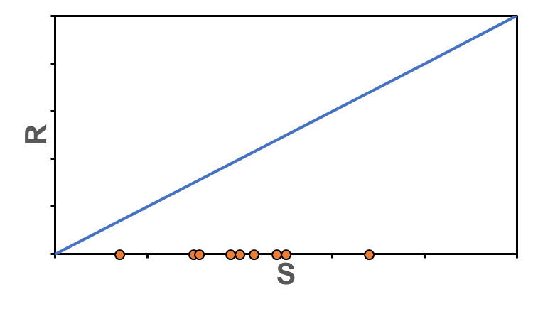
Targeted Stocks –
Few Escapement or Catch Data
The Situation
Notes:
Now our plot of the data look something like this…
We have some escapement data or indexed counts. But you have little to no idea where they might lie on the theoretical stock-recruit relationship.

Slide 12
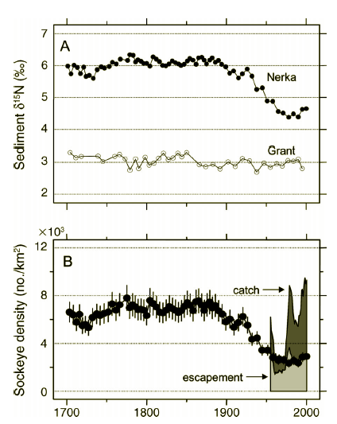
Targeted Stocks –
Few Escapement or Catch Data –
Paleolimnology Model to Estimate S_{EQ} for
Sockeye:
Based on premise that magnitude of historical escapements are recorded in lake sediments as quantities of marine derived nitrogen (MDN)
Recent escapement data used to “calibrate” MDN values in recent sediment layers to convert MDN in pre-fishery sediment layers to numbers of salmon
Requires:
sockeye are predominant anadromous species spawning in the lake
suitable reference lake with no anadromous fish runs
Schindler, D.E. et al. 2005. Marine derived nutrients, commercial fisheries, and production of salmon and lake algae in Alaska. Ecology 86: 3225-3231.
Notes:
One possible method that can be used is the paleolimnology model for lake rearing sockeye.
Cores of the sediment from the lake of interest are analysed and the fraction of nitrogen derived from marine sources of nitrogen (the heavier isotope of nitrogen) is estimated and each layer of the core dated.
Along with some recent escapement data and a mixing model one can estimate the number of salmon escaping prior to the start of fishing, which can be construed as the equilibrium abundance (S_{EQ}) of the lake.
From there, one can estimate S_{MSY} using the equations you were introduced to in the previous lecture and some assumptions about productivity of the stock (i.e. ln alpha) from other populations. Once you have an estimate of S_{MSY} an escapement goal can be developed.
I won’t go into any more detail because we have not used this method for establishing an escapement goal – I am just mentioning it so that you know it is an available method.

Slide 13
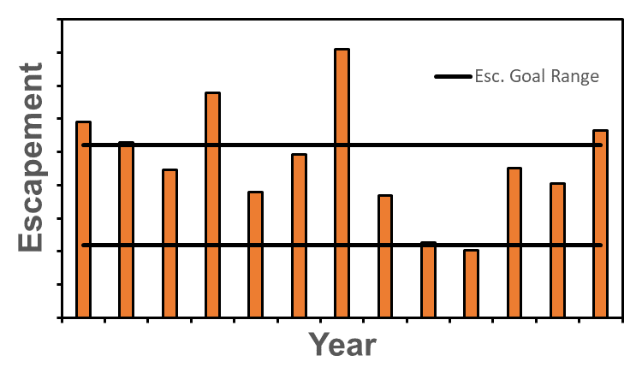
The Percentile Approach: (1)
Department needed simple method to develop escapement goals in data-limited situations
Objective is to attempt to keep escapements at levels currently observed, and ideally encompass S_{MSY}
Notes:
Prior to 2001, and establishment of the Sustainable Salmon Fisheries Policy and the Escapement Goal Policy, the department did not have any approaches to estimate SEGs.
The department developed a technique based on the percentiles of observed escapements. It was applicable to stocks with a series of escapement estimates, or index counts, where it was perceived that the historical harvest regime was sustainable.
Without data on catches, S_{MSY}, is unknowable for such stocks. The objective is to keep escapements at levels currently observed.
This approach is simple, robust, and applicable to a variety of data limited stocks (i.e. a series of escapements).

Slide 14
The Percentile Approach: (2)
Originally 4 recommended percentile ranges based on:
perceived harvest rates
contrast in escapement data
Very popular for establishing SEG and lower bound SEGs
How well did this approach serve as a proxy for SMSY?
Department evaluated the Percentile Approach:
Clark et al. 2014. An evaluation of the percentile approach for establishing sustainable escapement goals in lieu of stock productivity information. ADF&G, Fishery Manuscript No. 14-06, Anchorage.
Notes:
Originally, there were 4 different percentile ranges based on perceived harvest rates and contrast in the escapement numbers (contrast = max escapement/min escapement). These were considered important because they give you an idea of where you are with respect to the unknown equilibrium of the stock as well as how much information your data has (i.e. contrast).
The percentile approach is so simple to use that is very popular in establishing SEG ranges; in fact, about 50% of all goals statewide are based on the percentile approach (and ~80% of SEGs).
However, over time questions began to arise about how well this approach served as a proxy for S_{MSY}. Such questions motivated this evaluation which used theoretical, simulation and empirical methods.

Slide 15
Results of Evaluation
The Percentile Approach: (3)
4 tiers were sub-optimal
Upper bound > 75th percentile too high
Lower bound of 25th percentile greater than necessary
Replace 4 tiers with 3 tiers – better proxy of S_{MSY}, better yields
Limitations of Clark et al. (2014)
Ricker, Rating, Age Comp, Parameter Values
Notes:
Results of this evaluation indicated the 4 tiers of the percentile approach that were originally recommended were likely sub-optimal as proxies for determining an escapement range around S_{MSY}.
Clark et al. concluded that SEG ranges with upper bounds >75th %ile may include escapements at or above S_{EQ}, which would not be sustainable. They also concluded that SEG with lower bounds at the 25th %ile appeared to be somewhat higher than necessary.
Clark et al. recommended replacing the 4 tiers with modified 3 tiers that incorporate escapement measurement error into the rubric. The results of the evaluation indicated these 3 tiers give SEG ranges that are more robust to a wide variety of factors, provide a better proxy of S_{MSY}, and useful to management to attain escapements that produce better yields.

Slide 16
The Percentile Approach: (4)
Recommended percentile ranges
Tier | Percentile Range
high contrast (> 8) low/moderate harvest (< 0.4) high measurement error | 20th – 60th
high contrast (> 8) low/moderate harvest (< 0.4) low measurement error | 15th – 65th
low contrast (< 8) low/moderate harvest | 5th – 65th
Do Not use percentiles if:
avg. harvest rate > 0.4
very low contrast (< 4) & high meas. error
Notes:
Recommended 3 tiers of the percentile approach are based primarily on contrast in the data and measurement error.

Slide 17
The Percentile Approach: (5) – an example
Chilkat Chinook
Order
Escapement
Contrast = 4
Ericksen, R.P., and S.A. McPherson. 2004. Optimal production of Chinook salmon from the Chilkat River. ADF&G, Fishery Manuscript No. 04-01, Anchorage.
Notes:
Here is an example of using the percentile approach on Chilkat Chinook.
Assuming we only have escapement estimates. The contrast in our escapement data is low – only 4 – and the harvest rate on this stock is low. In this case we would use the 5th and 65th percentiles for developing an escapement goal.
The shaded area on the table on the right shows the escapements within the 5th and 65th percentile and the calculated values are at the bottom. These would likely be rounded to 2,200 to 5,200 for the SEG.

Slide 18
Procedures for Choosing
BEGs, SEGs, or ….
MANY
Escapement
AND
FEW Catch data
Escapements counted/estimated; few stock-specific catch counts/estimates
Chinook
Coho
“lake” sockeye
Pinks
Chums
“river” sockeye
High
Harvest Rate
Low to
Moderate
Harvest
Rates
Very Low
Harvest Rate
High
Harvest Rate
>40%
Low to
Moderate
Harvest
Rate
Very Low
Harvest Rate
BEG
“validated”
habitat or
paleo model
No
Goal
Needed
(Low HR only)
No
Goal
Needed
Improve
Stock
Assessment
SEG
Percentile
Approach
No
Goal
Needed
SEG
Percentile
Approach
LBSEG
discounted
Ŝ_{EQ}
LBSEG
discounted
Ŝ_{EQ}
LB SEG
“validated”
habitat or
paleo model
Notes:
Now we have the situation of many escapement estimates and possibly a few catch estimated. Still not enough to do a full-blown SRA, but we can now begin to talk about developing a BEG for some situations.
We can also start to look at other tools to develop lower bound SEGs for stocks with very low harvest rates.
A BEG in this situation would come from validating one of our habitat or paleo models, not from a stock-recruit analysis.

Slide 19
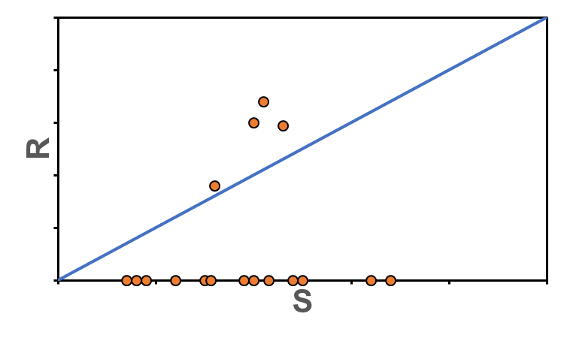
Targeted Stocks –
Many Escapement but Few Catch Data
The Situation
Notes:
Now we have some catch estimates to go with our escapements. These will be actual escapements or expanded counts instead of an index. We are starting to get some idea of how hard we are fishing and where our data lie on the spawner-recruit curve.

Slide 20
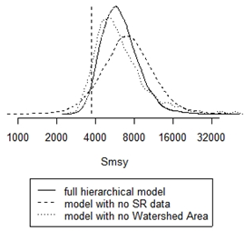
“Validating” Habitat Models – Bayesian Approach:
Create the hierarchical model:
Chinook Watershed Model
Use informative priors on parameters and condition on observed data
Generate posterior distribution for parameters and for S_{MSY}
More brood years with good contrast
will move S_{MSY} generated from hierarchical model from watershed model estimate towards SRA estimate
Liermann, M.C., et al. 2010. Using accessible watershed size to predict management parameters for Chinook salmon, Oncorhynchus tshawytscha, populations with little or no spawner-recruit data: a Bayesian hierarchical modeling approach. Fish. Manage. Ecol. 17:40-51
Notes:
This is a situation in which we can use the hypothesized production from the model as a prior for a Bayesian analysis.
For example, with the Chinook watershed model we can use the model output as a prior for S_{MSY} and then add our observed data in to generate a posterior for the production relationship.
Be sure to talk to your biometrician for help with this procedure.

Slide 21
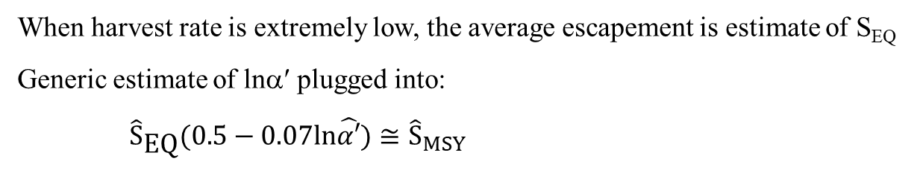
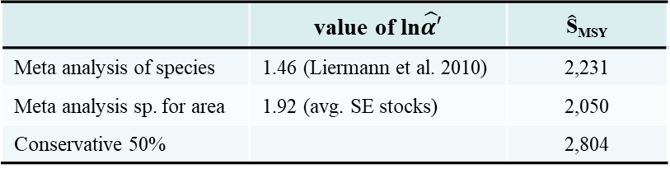
Discounting S_{EQ} to develop an SEG:
When harvest rate is extremely low, the average escapement is estimate of S_{EQ}
Generic estimate of lnα′ plugged into:
${\hat{S}}_{\text{EQ}}(0.5−0.07ln\hat{α′})≅{\hat{S}}_{MSY}$
Chilkat Chinook
Year | S | Harvest Rate | R | R/S
1991 | 5,897 | 0.04 | 12,932 | 2.19
1992 | 5,284 | 0.02 | 5,542 | 1.05
1993 | 4,472 | 0.11 | 3,321 | 0.74
1994 | 6,795 | 0.05 | 1,645 | 0.24
1995 | 3,790 | 0.07 | 4,348 | 1.15
1996 | 4,920 | 0.08 | 5,637 | 1.15
1997 | 8,100 | 0.07 | 7,081 | 0.87
Early Avg. | 5,608 | 0.06 | 5,787 | 1.06
1998 | 3,675 | 0.10
1999 | 2,271 | 0.19
2000 | 2,035 | 0.06
2001 | 4,517 | 0.07
2002 | 4,051 | 0.10
2003 | 5,657 | 0.09
Later Avg. | 3,701 | 0.10
Overall Avg. | 4,728 | 0.08
 | value of ln$\hat{α′}$ | $\hat{\text{S}}$_{MSY}
Meta analysis of species | 1.46 (Liermann et al. 2010) | 2,231
Meta analysis sp. for area | 1.92 (avg. SE stocks) | 2,050
Conservative 50% |  | 2,804
1991-1997 data used in example (HR incr. later yrs)
Avg. escapement = 5,608
Similar to watershed model est. S_{EQ} = 5,736
Goals would be SEGs
could make argument that first two could be BEGs
T & M - Many Esc & Few Catches
73
Notes:
73
When we have many (at least 10) estimates of escapement and know that exploitation rate is very low, we can also use spawner-recruit theory to estimate equilibrium abundance (S_{EQ}). In this case, the average escapement is an estimate of S_{EQ}. Simulation of this process indicates that having at least 10 years of data should give us a pretty good estimate of S_{EQ}.
Here we use Chilkat River Chinook again as an example, but only the early data where harvest rate was very low.
Of course we do not know what alpha is or have a good estimated of S_{MSY} so an escapement goal developed from this would clearly be an SEG.

Slide 22
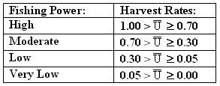
Procedures for Choosing
BEGs, SEGs, or ….
MANY
Escapement
AND
Catch data
Escapements counted/estimated; many stock-specific catch counts/estimates
Chinook
Coho
“lake” sockeye
Pinks
Chums
“river” sockeye
High
Harvest
Rate
Moderate
Harvest
Rate
Low
Harvest
Rate
Very Low
Harvest
Rate
High
Harvest
Rate
Moderate
Harvest
Rate
Low
Harvest
Rate
Very Low
Harvest
Rate
SEG RANGE
Û_{MSY}
from SRA
BEG
Ŝ_{MSY}
from SRA
LB SEG
Ŝ_{MSY}
from SRA
LB SEG
discounted
Ŝ_{EQ}
SEG RANGE
Û_{MSY}
from SRA
BEG
Ŝ_{MSY}
from SRA
LB SEG
Ŝ_{MSY}
from SRA
LB SEG
discounted
Ŝ_{EQ}
BEG
Ŝ_{MSY} from
“validated”
habitat or
“paleo” model
BEG
Ŝ_{MSY} from
“validated”
habitat or
“paleo” model
LB SEG
Ŝ_{MSY} from
“validated”
habitat or
“paleo” model
LB SEG
Ŝ_{MSY} from
“validated”
habitat or
“paleo” model
Notes:
The last flow chart for targeted stocks is for stocks with many escapement and catch estimates so that a brood table can be constructed. Here we have many options for choice of goal and the type of analysis used.
Harvest rate plays a role in the analysis we can conduct. Only for fisheries that have enough fishing power to take the entire surplus production or more do we need a range. For some species we can use our habitat or paleo model to validate our S-R data or we can conduct a full stock-recruit analysis (next chapter of the course).
One new analysis we can conduct, especially when harvest rates are high is to use the relationship between ln(a) and exploitation rate at MSY to gauge whether our current goal range is too high too low or just right relative to S_{MSY}…

Slide 23
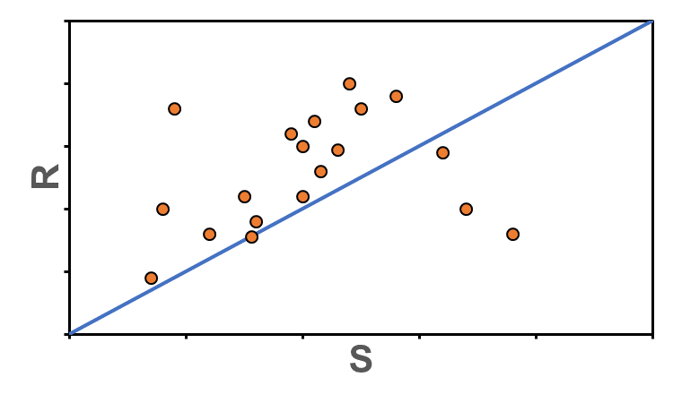
Targeted Stocks –
Many Escapement and Catch Data
The Situation
Notes:
Now we have enough data to fill in the typical brood table. If we’re lucky our data might look like this.

Slide 24
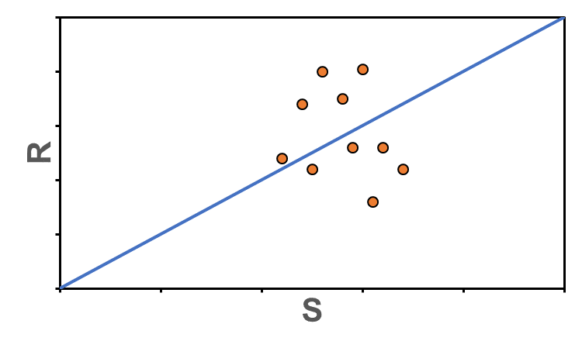
Targeted Stocks –
Many Escapement and Catch Data
The Situation
Notes:
Or this.

Slide 25
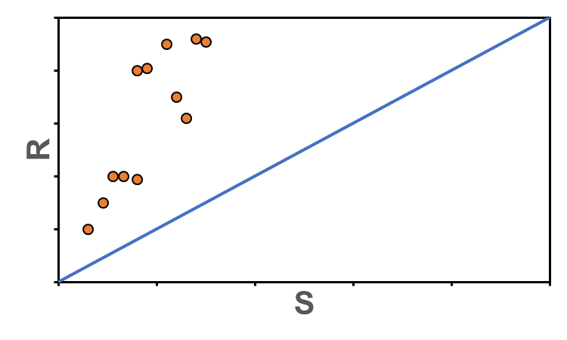
Targeted Stocks –
Many Escapement and Catch Data
The Situation
Notes:
But it might look like this…

Slide 26
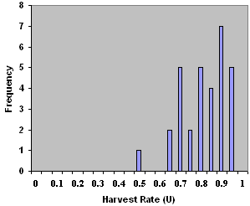
SEG range based on
from stock-recruit data: (1)
From estimate of Ricker’s curve (regress observations of ln(R/S) against S to estimate lnα′):
Used when have imprecise estimate of β, a common consequence of high harvest rates (U).
Kenai Sockeye
To increase expected yield:
Notes:
Exploitation rate at MSY can be estimated from the estimate of ln(a) from a Ricker curve, especially when we cannot reliably estimate the beta parameter for the Ricker.
This means we cannot reliably estimate S_{EQ} but we can estimate the intrinsic rate of increase or ln(a). If the estimated exploitation rate at MSY is lower than what is observed then we should probably increase the goal, which will be an SEG (we do not know what S_{MSY} is).
Kenai sockeye are a good example of this…

Slide 27
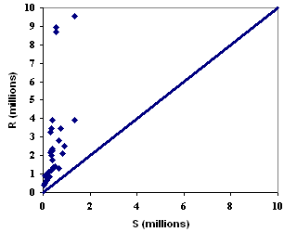
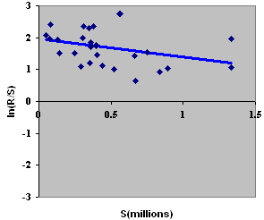
SEG range based on
from stock-recruit data: (1)
From a fit using log-transformed version of Ricker’s curve:
H_{o}:β = 0 is not rejected (P=0.08)
Range of SEG can be based
on ability to manage.
Note: there has been surplus production in every brood year.
vs.
Comparison indicates
that current SEG should
be increased (slightly) to
get closer to a BEG.
Kenai Sockeye
Notes:
When do the stock-recruit analysis for Kenai sockeye, we find that we can get a very precise estimate of ln(a) but the beta estimate is very imprecise, and so is the estimate of S_{EQ}. U_{MSY} in this case is 74% where the observed average exploitation rate is 81%. This means we could increase the SEG range slightly, but we still do not know what S_{MSY} is (or S_{EQ}).
Note that this exercise is in the lab…

Slide 28
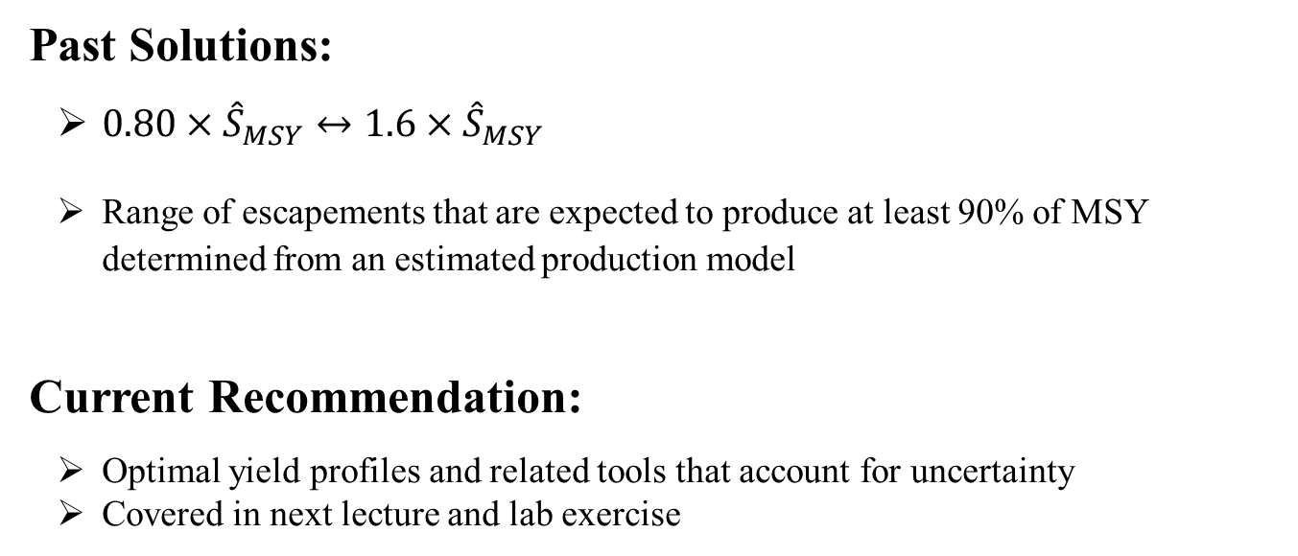
Targeted Stocks –
Determining the Range of the BEG:
Past Solutions:
$0.80×{\hat{S}}_{MSY}↔1.6×{\hat{S}}_{MSY}$
Range of escapements that are expected to produce at least 90% of MSY determined from an estimated production model
Current Recommendation:
Optimal yield profiles and related tools that account for uncertainty
Covered in next lecture and lab exercise
Eggers, D.M. 1993. Robust harvest policies for Pacific salmon fisheries, p. 85-106 In Proceedings of the International Symposium on Management Strategies for Exploited Fish Populations, Alaska Sea Grant College Program, Fairbanks, AK
confidence or credibility intervals ≠ escapement goal ranges
Notes:
Several methods have been used by the department to set BEG ranges.
In the 1990s Eggers proposed using 80% to 160% of the point estimate of S_{MSY} based on results from simulations. More recently the range expected to produce 90% or more of MSY has been used.
Our current recommendation is to use some graphical tools such as optimal yield profiles, which address uncertainty in the estimate of S_{MSY} and provide helpful probability statements about yield and other performance metrics.
The next lecture and lab will lay out these methods in detail.

Slide 29
Targeted Stocks –
Determining the Range/Lower Bound of the SEG:
High Fishing Power and Inseason Management w/ an SEG range:
Range judged by managers to be broad enough to avoid a possible “whip-saw” management concern while maintaining the status quo.
Range that has in the past resulted in fishing annually.
No Inseason Management (most likely a Lower Bound SEG):
If S_{MSY} can be estimated, the goal should be the lower end of the BEG range around the estimate of S_{MSY} (although the goal will be an SEG).
If no estimate of S_{MSY} is available, the goal will most likely be a function of the mean of past escapements designed to preserve the status quo.
Inseason Management and Low Fishing Power:
Forget the goal and drop the inseason management; neither are needed.
Notes:
Some practical advice on setting goal ranges…

Slide 30
Targeted Stocks –
SEGs and the Status Quo:
While there is only one escapement S_{MSY} that will maximize the expectation of yield from a targeted stock, there are many escapements that could provide sustainable yields. Which set of these escapements should be the preferred SEG?
Most often the preferred SEG is the one most likely to perpetuate the status quo in the fishery. If past escapements have produced a “successful” fishery, users will be reluctant to change goals for the sake of “experimentation”, or even to increase yields in the long-term. Social and economic history provides an inertia that defines the preferred SEG.
Notes:
Advice on SEG’s and the status quo…

Slide 31
Targeted Stocks –
Being Prepared to Change Goals:
If a goal is to be meaningfully raised or lowered, EGA should include projections of:
Short-term losses and long-term gains in average yield expected from the change;
Likely frequency of restrictions and closures with the new goals; and
Likely impacts (if any) on allocation of yields among users.
These questions invariably arise before the Board whenever a big change in goals is on the table. Simulation of fitted models or generic models based on habitat can be vehicles for this analysis. Be proactive.
Notes:
Make sure an escapement goal analysis includes the interaction between the goal (especially one that will change) and the management to achieve the goal.

Slide 32
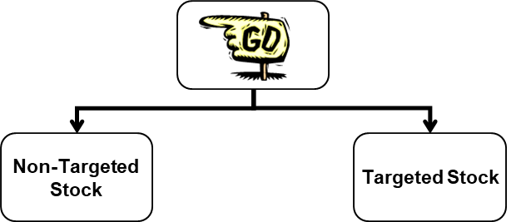
Non-targeted Stocks: (1)
Purpose of a goal for a non-targeted stock is to provide sustained yields with a low probability of having a “management concern” under current fishing power and stock productivity.
Each potential lower bound SEG carries with it a risk of having a management concern because of random variation in harvest rates and in random process error.
That risk can be estimated from past observations of escapement for any potential lower bound SEG, or a lower bound SEG can be determined that will carry an acceptable risk of an unnecessary management concern.
Past observations of escapement are presumed to represent a stable (stationary) level of fishing power, a stable (stationary) level of productivity, and a consistent management regime.
Notes:
On to non-targeted stocks…
Why have a goal for a non-targeted stock? We are trying to sustain yields from the non-targeted stock while avoiding a management concern that will affect the fishery for the targeted stock. We need to address this risk. Assuming we only have escapements from the non-targeted stock, we could conduct an assessment of risk of management concern given the targeted stock has been and will continue to be fished in the same way.

Slide 33
Non-targeted Stocks: (2)
Risk Analysis
Assess probability that series of low escapements occur in a row
Uses normal probability theory to estimate risk of this occurrence, which might generate a management concern
Balance with risk of not detecting a real drop in mean escapements over time
Note
Important to assess whether escapement data are serially correlated
Method does not mandate maximum risk level
Risk Analysis Does not provide an escapement goal recommendation
Rather it describes the risk for given escapement goal
Bernard, D.R. et al. 2009. Estimating risk of management error from Precautionary Reference Points (PRPs) for non-targeted salmon stocks. Alaska Department of Fish and Game, Special Publication No. 09-09, Anchorage.
Notes:
With the Risk Analysis method, developed by Bernard et al., we can calculate the probability of a series of low escapements occurred in a row which might generate a management concern. If the escapement data are log-normally distributed we could use normal probability theory to estimate the risk of this occurrence. We then want to balance this risk of having a management concern when none was warranted with the risk of not detecting a real drop in the mean escapements over time.
It should be noted that…

Slide 34
Non-targeted Stocks: (3) – example
The probability of observing 3 years in a row below 8,000 fish in the escapement survey is ~7% or once in 14 years. A 90% drop in the mean survey would also be detected ~93% of the time at a lower bound SEG of 8,000. The management objective in this case is to maintain the existing average escapement survey of 22,443 fish, while avoiding a management concern.
Escapement
Notes:
Here is an example – Kulukak sockeye are harvested along with other stocks nearby (likely Togiak sockeye) but the inseason management calls are not based on this stock. If we account for the fact that observed escapements are serially correlated (an important diagnostic to check with this method) we calculate that a lower bound SEG of 8,000 fish would have a probability of 7% (once in 14 years) of a management concern. We would also calculate a similar probability that we could detect a drop in mean escapement of 90%.
Risk Analysis is tricky to wrap your head around and we recommend that you read the report by Bernard et al. that describes this method and consult a biometrician if you have a stock for which you would like use this method.

